Slide 1
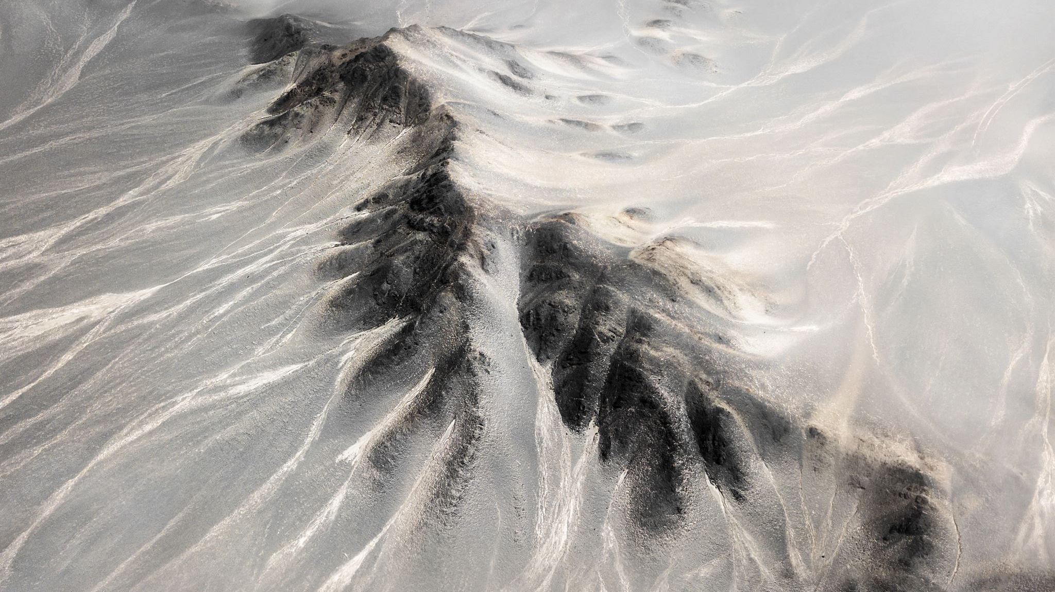
The Moving Crust
Chapter 5
Lesson 2

Slide 2
Pair up
-Turn to the person sitting next to you.
-Discuss what we think tectonic plates are.

Slide 3
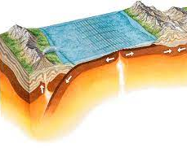
Tectonic Plates
The large sections that make up earth’s crust and upper mantel are called tectonic plates.

Slide 4
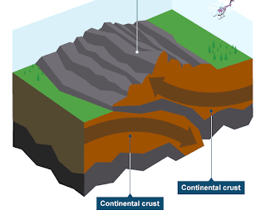
Folds
When plates slowly ram into each other, they can form bended rock layers, called folds

Slide 5
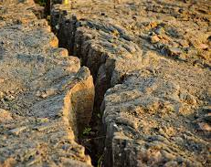
Fault
A long, narrow crack in earth’s crust is called a fault.

Slide 6
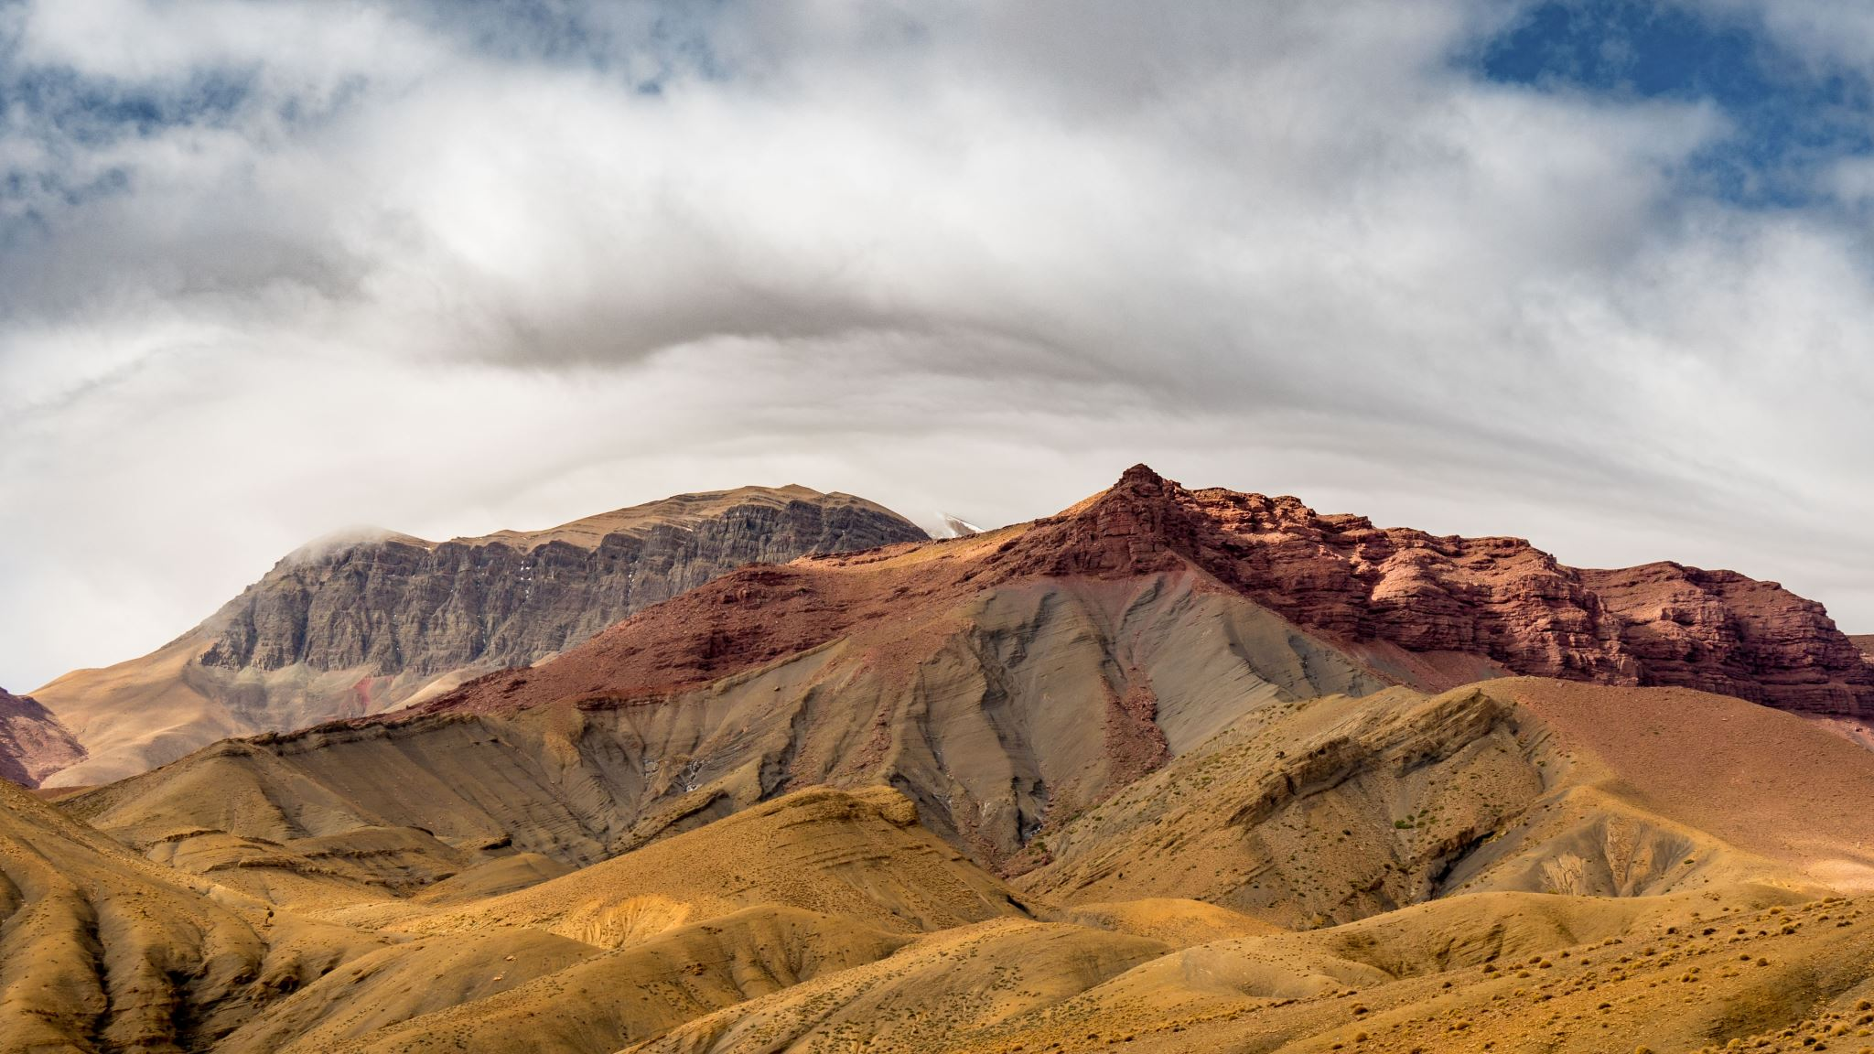
Mountains
Tall landforms caused by folding or faulting are called mountains

Slide 7
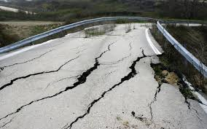
Earthquake
If the rock in earth’s crust suddenly shakes, an earthquake occurs.

Slide 8
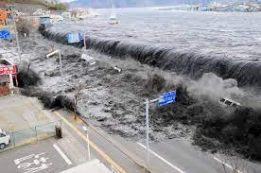
Tsunamis
Underwater earthquakes can cause huge ocean waves, called tsunamis.

Slide 9
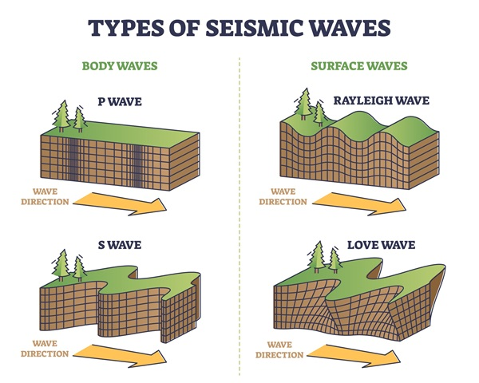
Seismic Waves
The source of an earthquake creates seismic waves that travel outwards.

Slide 10
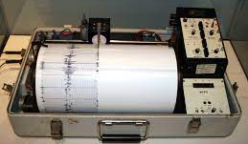
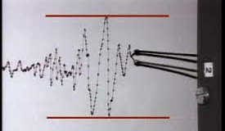
Seismograph
A tool that graphs seismic waves as wavy lines is called seismograph.

Slide 11
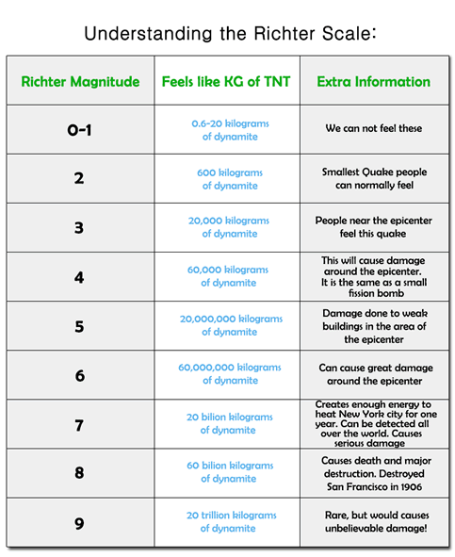
How we measure the strength.
-The magnitude of an earthquake is how strong the earthquake is.
-The Richter Scale is how the magnitude of earthquakes are rated.

Slide 12
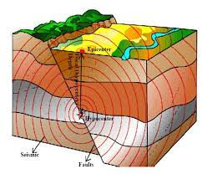
Seismic waves travel at different speeds along earth’s surface and through earths interior.

Slide 13
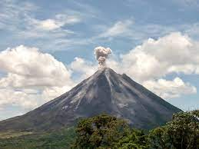
Volcano
A mountain that forms around an opening in earth’s crust is a volcano.

Slide 14
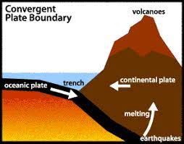
Most volcanoes form near plate edges.

Slide 15
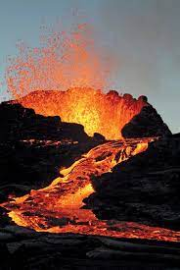
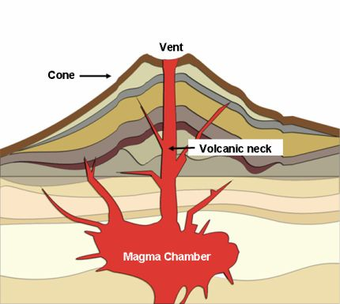
Magma/Lava
A volcano is produced by melted rock, called magma, which erupts onto the surface as lava.

Slide 16
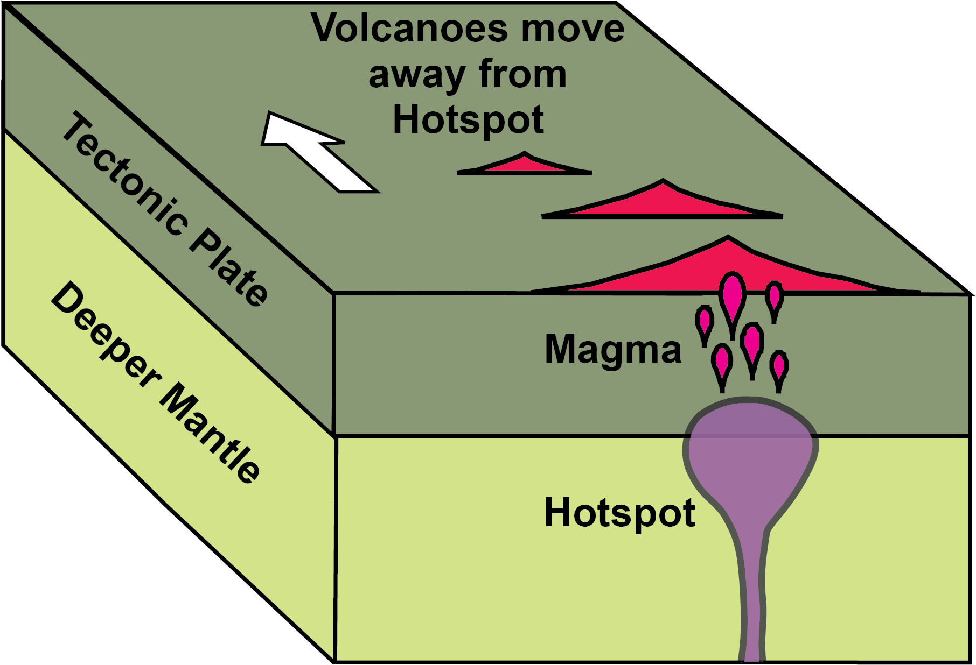
Hot Spots
Some volcanos form over thin places in earth’s curst, called hot spots.

Slide 17
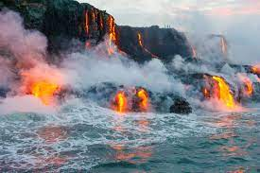
In the Pacific ocean, an example of volcanoes that formed over a hot spot is the Hawaiian islands.

Slide 18
Quick Think
1 Sentence
1 Minute
1 Idea about what we think it looks/happens when a volcano erupts.

Slide 19
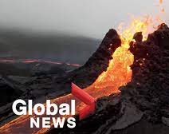
A volcano eruption can send out melted rock (lava), gases, ash, or rocks into the air.
https://www.google.com/url?sa=t&rct=j&q=&esrc=s&source=video&cd=&cad=rja&uact=8&ved=2ahUKEwiWtdzW9f36AhWBK1kFHT9ABdMQtwJ6BAgGEAI&url=https%3A%2F%2Fwww.youtube.com%2Fwatch%3Fv%3DCgpNqrR318U&usg=AOvVaw1NNYCumGO8aRyKUWZqa17h

Slide 20
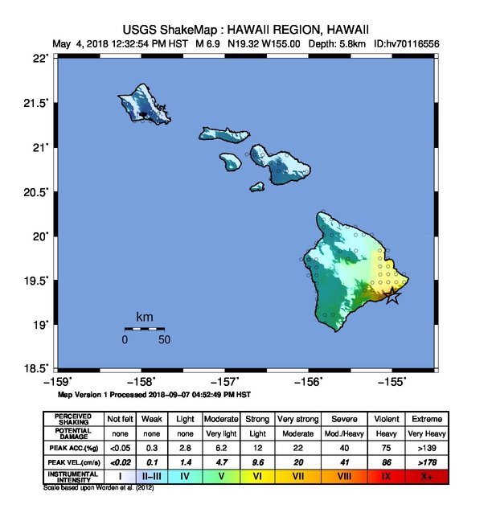
Hawaii
There are small earthquakes in Hawaii, but not real strong ones because strong earthquakes occur near plate boundaries.

